Slide 1
WELCOME
TO
PRESENTATION

Slide 2
Image Processing in MATLAB with Graphical User Interface (GUI) Environment
SUPERVISED BY:
ABHIJIT CHAKRABORTY
Assistant Professor
Department of Computer Science And Telecommunication Engineering,
Noakhali Science And Technology University
SUBMITTED BY:
Abdulla Al Mamun
Roll: ASH1201009M
&
S.M. Shafkat Islam
Roll: ASH1201064M

Slide 3
Abstract
This paper presents information on wide aspects of the computer
graphics, introduction to MATLAB and its Image Processing Toolbox.
Cascade classifier is utilized as the algorithms for this object detection
system and Patch based inpaint is utilized as the algorithms for
removing object system.
MATLAB with GUI environment is used to find & remove the different
features of the object of interest from random images.

Slide 4
Overview
Objectives
Tools
Image processing
Graphical User Interface (GUI)
Edge Detection
Object Detection
Cascade Classifier
Snap shots of the procedures
Remove Object using Inpainting
Future Plan of the Research
Conclusion

Slide 5
Objectives
Detect Object and remove object from different images.
Object detection can be also used for people counting, it is used for analysing store performance or crowd statistics during festivals.
To identify products in industrial processes
Object removing system for removing unwanted image or recover pixel loss in images.

Slide 6
Tools
MATLAB R2013a
Image Processing Toolbox
Computer Vision System Toolbox
Cascade Trainer
Graphical User Interface(GUI)

Slide 7
Edge Detection
Pixel is a small unit of an Image
An edge pixel is described by using two important features
i) Edge strength
ii) Edge direction
There are many operators used for edge detection
We have mentioned about Canny operator

Slide 8
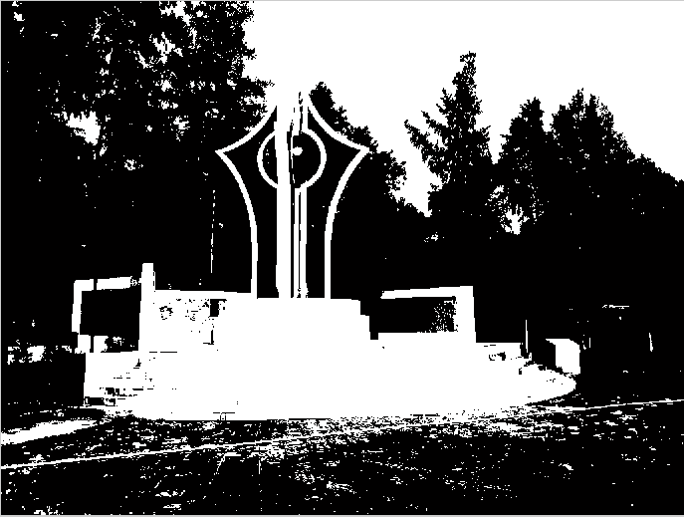
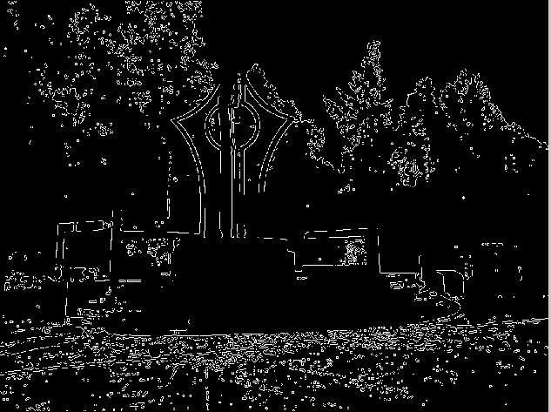
Snap shot of Canny edge detection

Slide 9
Object Detection
is the task of finding a given object in an image or video sequence
MATLAB Supports several approaches to object detection, including the Viola-Jones algorithm, feature-based matching, blob analysis, foreground detection, and template matching.
We have preferred Cascade Classifier technique.

Slide 10
Cascade Classifier
Development of Cascade Classifier object detection is categorized into two phase which are training phase and execution phase.
Cascade classifier training requires a set of positive samples and a set of negative images.
Each stage of the classifier labels the specific region defined by the current location of the window as either positive or negative –positive meaning that an object was found or negative means that the specified object was not found in the image

Slide 11
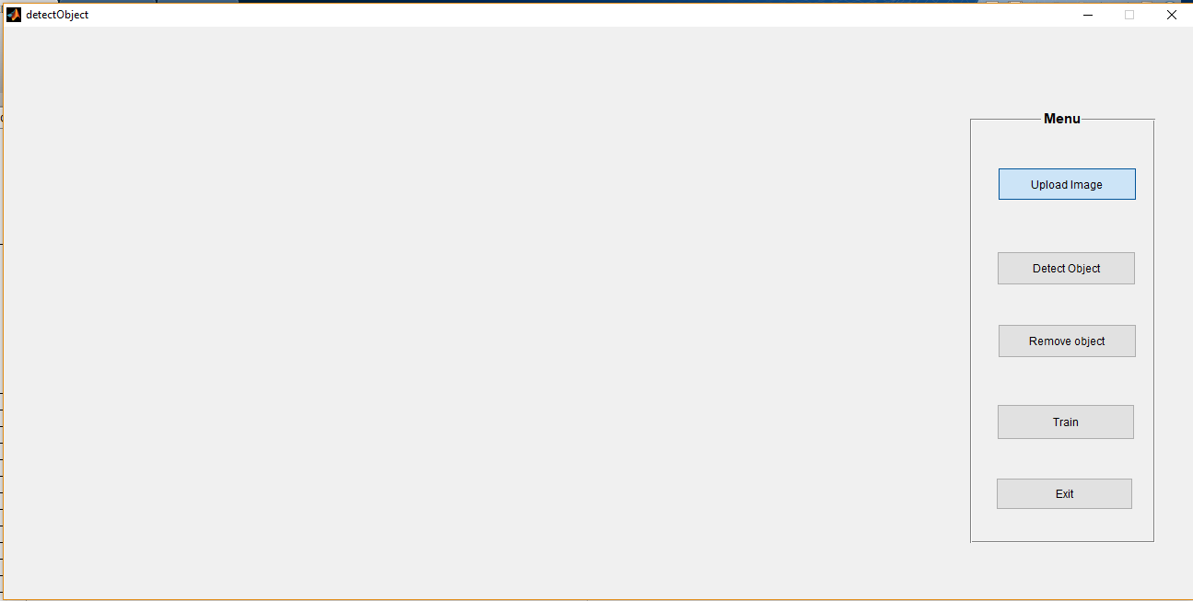
Snap shots of the procedure

Slide 12
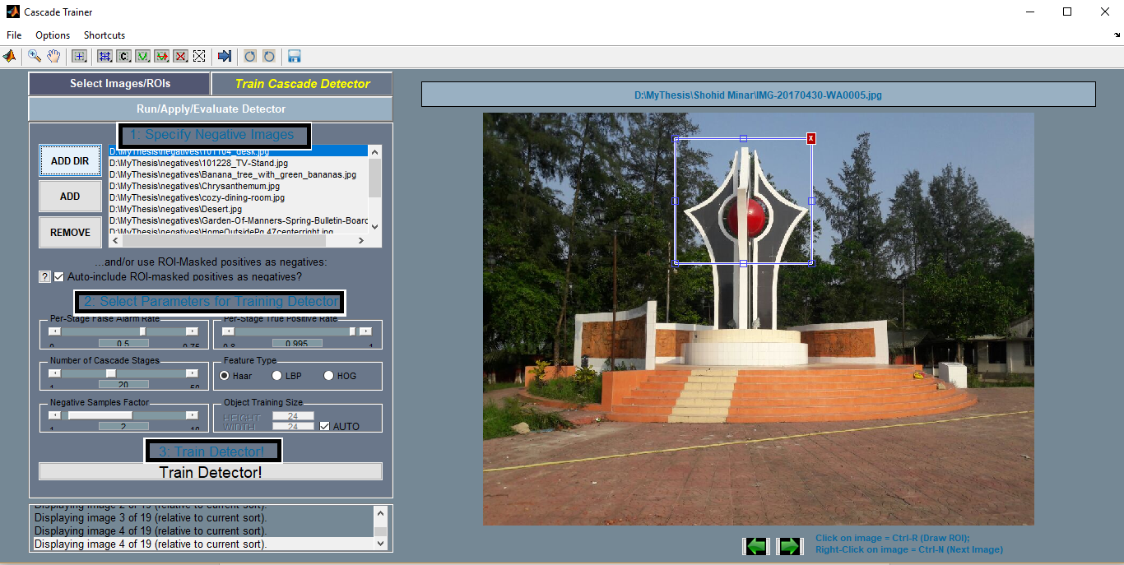
Snap shot of Cascade Training

Slide 13
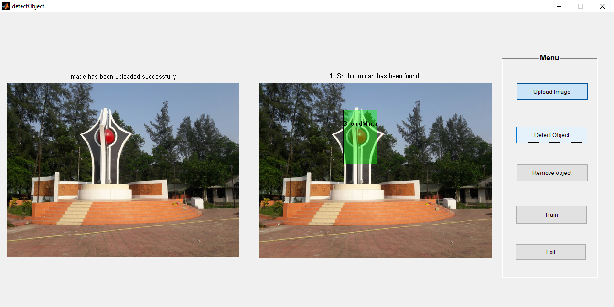
Snap shot of Object Detection

Slide 14
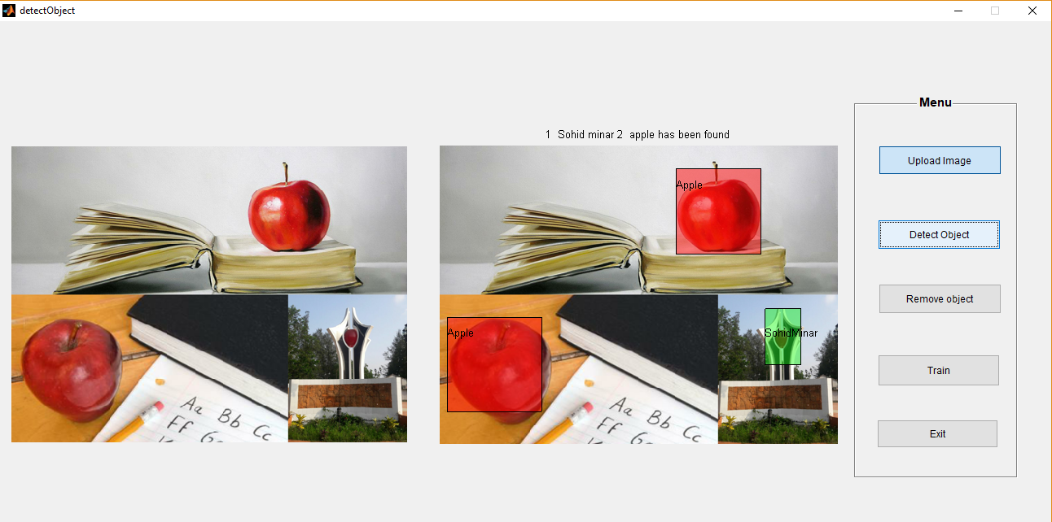
Snap shot of multiple Object Detection

Slide 15
Remove Object using Inpainting
Exemplar based image inpainting is carried out by Criminisi algorithm.
Remove the object (exemplar) from the original Image.
Find the fill front.
Find the priority of the pixels along the fill front using confidence and data terms.
Fill the unfilled pixels from the similar patch obtained.
Update the confidence value at the pixel which is filled.

Slide 16
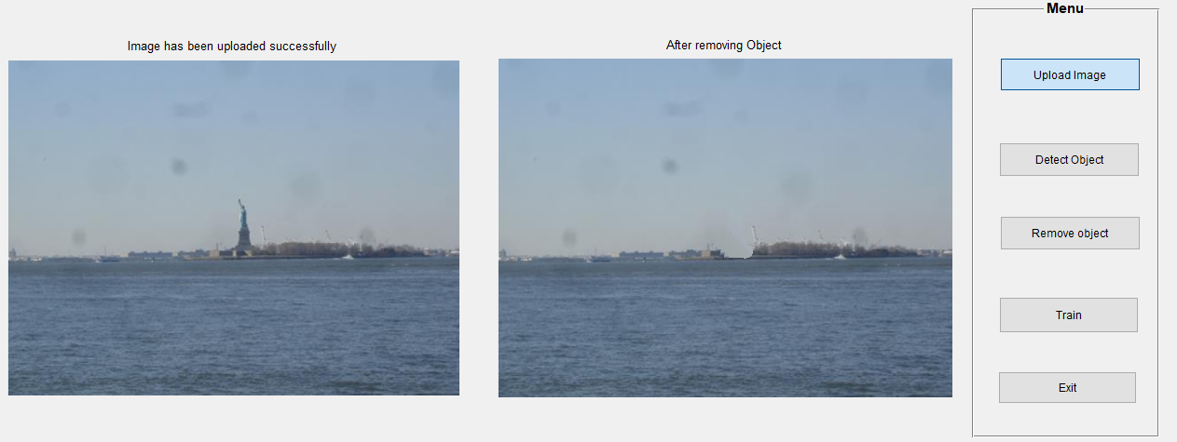
Snap shot of Object Removal

Slide 17
Future Plan of the Research
In this paper we tried to detect and remove various types of objects from a random images.
Our future plan is to detect various type of objects which isn’t already trained from randomly selected image and also make self decision about that object.
There are still a lot of possibilities for future development of our work.

Slide 18
THANK YOU

